Slide 1
Holistic Wellbeing
Mental, Physical, Social, and Financial
Confidentiality Notice: This document is confidential and contains proprietary information and intellectual property of Wellview, Inc. Neither this document nor any of the information contained herein may be reproduced or disclosed under any circumstances without the express written permission of Wellview, Inc. Please be aware that disclosure, copying, distribution or use of this document and the information contained therein is strictly prohibited.

Slide 2
We specialize in companies who care about their people.
We start with “why” to drive member activation
We keep our care in-house
Culture and employee experience focused leadership
Measurable results across claims, clinical and lifestyle data
Operating nationwide in over 40 states Supported in English and Spanish.
©2022 Wellview, Inc. – Confidential and Proprietary – Do Not Distribute

Slide 3
Well-being as a top strategic benefit
Well-Being Priorities:
#1 Emotional Well-being (86%)
Stress, burnout, depression
#2 Physical Well-being (68%)
Enhanced virtual medical services
#3 Financial Well-being (67%)
Savings, budgeting, loans, counseling
Two-thirds of employers recognize well-being as a key component of employee experience (EX) and have prioritized it as a strategic benefit objective over the next 2 years.
Source: 2021 Global Benefits Trends Survey, Willis Towers Watson
©2022 Wellview, Inc. – Confidential and Proprietary – Do Not Distribute

Slide 4
Overview Care Model

Slide 5
The Wellview Care Model
The Wellview Care Model™ was developed by a PCP and a Cardiac Surgeon who saw a need to help people take care of themselves. Book of Business analysis shows 8 - 11% claims cost reduction for engaged populations.
4 - Measurable Outcomes
Job Satisfaction: 91% maintained or improved
Absenteeism: study shows engaged members use ⅓ the sick time of non-engaged members
Diabetes - 80% improved or maintained A1c
Blood Pressure - 62% moved to healthier BP level
1 - Wellview Care Profile™
Behavioral & Health Personality Profile
Proprietary Health Risk Assessment
Biometrics
Wellview Care Model™
2 - Engagement & Education
Dedicated Health Advisor (Coach)
Ongoing Healthy Living content
Quarterly Healthy Living Workshops
3 - Clinical Care Team
Registered Dietitians, Personal Trainers, Diabetes Educators
Integrated Mental Health / Financial Wellness team
©2022 Wellview, Inc. – Confidential and Proprietary – Do Not Distribute

Slide 6
Wellview Care Model
A collaborative approach for care.
Health Advising
Connected care yields exponential results when everyone works toward the same goals informed by the same patient chart.
Mental Health
Registered Dietitian
Accredited Financial Coach
No silos. No gaps in care.

Slide 7
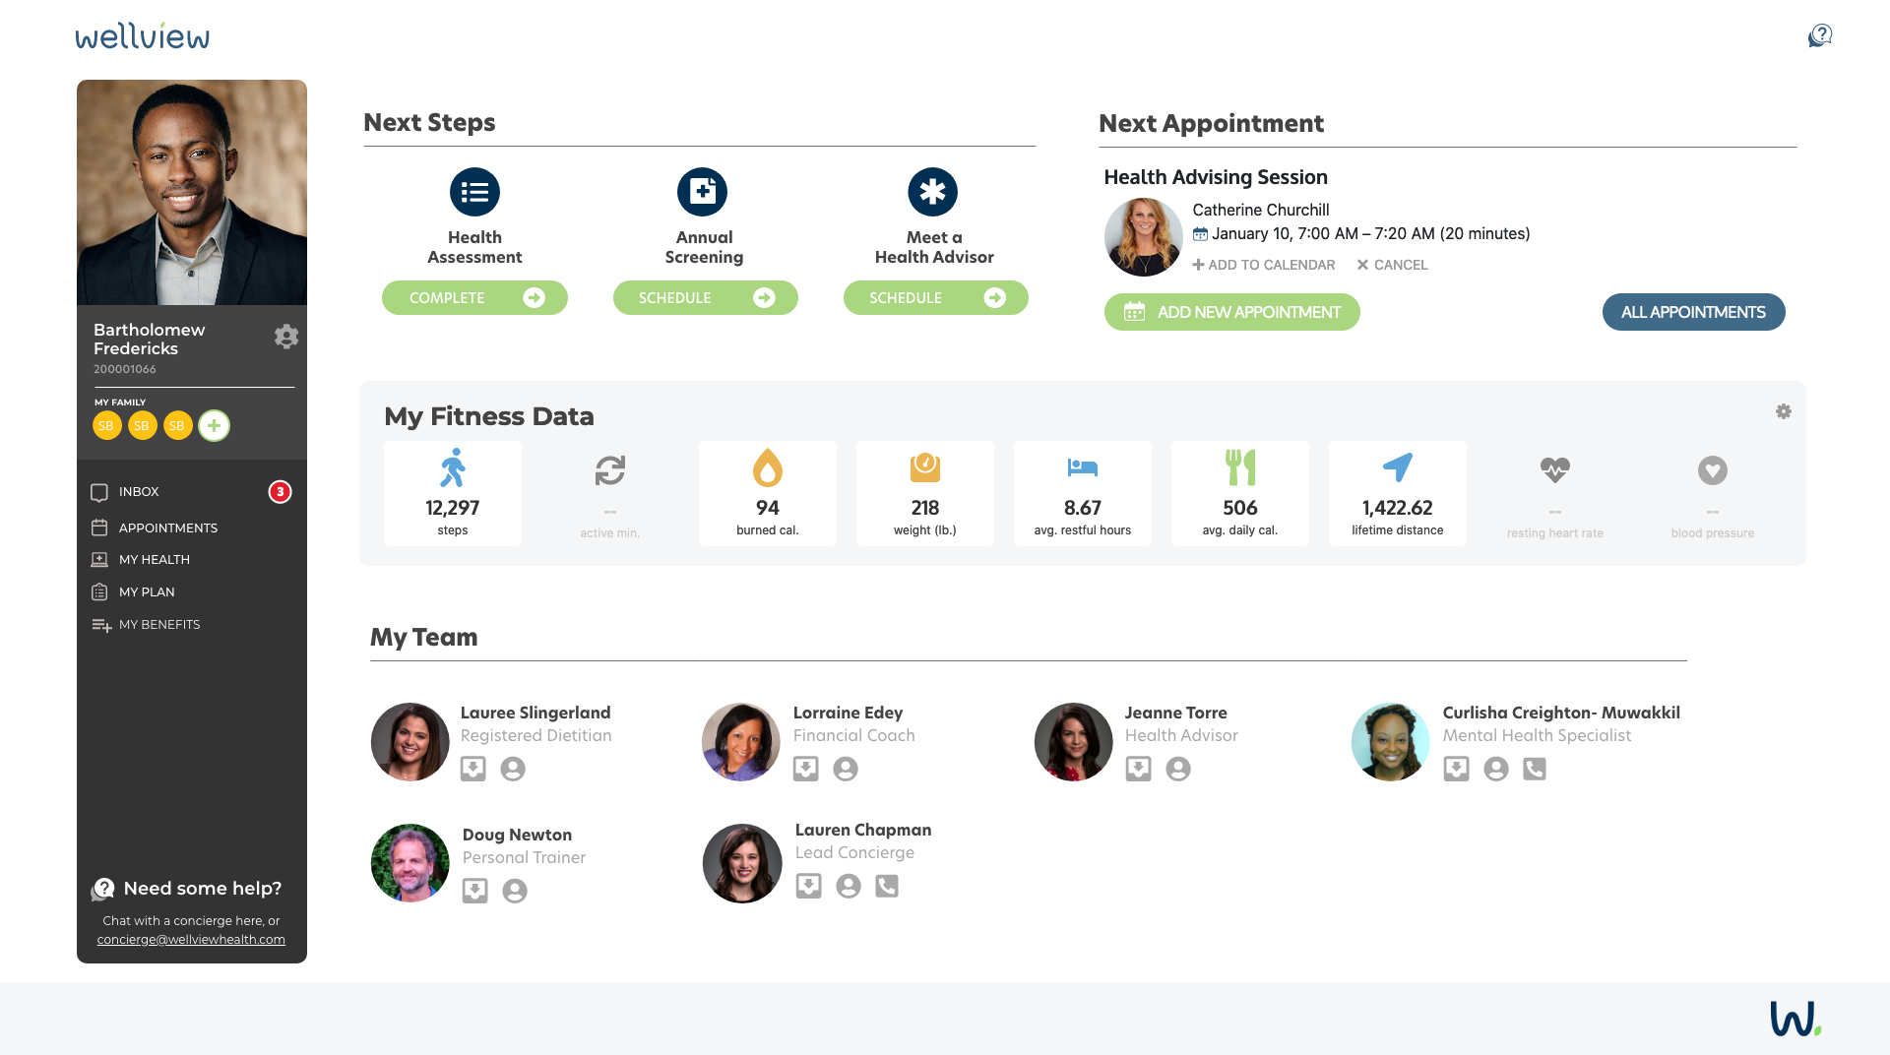
Full-Service Portal Home Screen

Slide 8
Participant Story of Impact
PARTICIPANT PROFILE:
Age: 51, Male
Weight: 378 lbs. / BMI 57
A1c: 6.9
Medical History: Diabetes, Sleep Apnea, Hypertension, Heart Disease
Ready-to-Change: Stress, Diet, Exercise
Barriers to Change: Motivation, Confidence
Health Personality: Healthy for Life
OUTCOMES:
Weight: 308 / BMI 46
70 pound wt loss (19% wt change)
A1c: 5.6
Other outcomes:
Improved Sleep
Better Nutrition
Consistent Exercise
Medication Adherence
WELLVIEW INTERVENTIONS:
Health Screening and Health Assessment
Health Advisory sessions
Dietitian sessions
Wellview engagement is ongoing
“
Having the support of Wellview and someone to talk to gave me motivation and confidence to change. I am taking care of my health and feeling better overall in my mind and body.
©2022 Wellview, Inc. – Confidential and Proprietary – Do Not Distribute

Slide 9
Overview Implementation

Slide 10
Health Plan Employees
Health Plan Spouses
Health Plan Dependents (+18 years old)
Who can
participate?

Slide 11
Three Best Practices for Success
Leadership Advocacy
Peer-level Champions
Coordinated Launch
We’ve developed a personalized experience and proven strategy that yields our industry-leading engagement.
But, your people trust you first.
Follow our short list of best practices to engage your organization and create a culture of health.
©2022 Wellview, Inc. – Confidential and Proprietary – Do Not Distribute

Slide 12
Wellview
Client Roadmap
Toolkit with key resources and materials shared with each organization.
June 2022 - Benefits start
NC Bankers send reminder to association members. Organizations can remind their employees.
STEP 2
STEP 4
Member Journey Begins
STEP 1
STEP 3
STEP 5
May 2022
Announcement to Association CEOs and HR
CEOs and HR utilize toolkit to generate excitement.
Organizations must whitelist Wellview.
Wellview sends Welcome Campaign to employees.
©2022 Wellview, Inc. – Confidential and Proprietary – Do Not Distribute

Slide 13
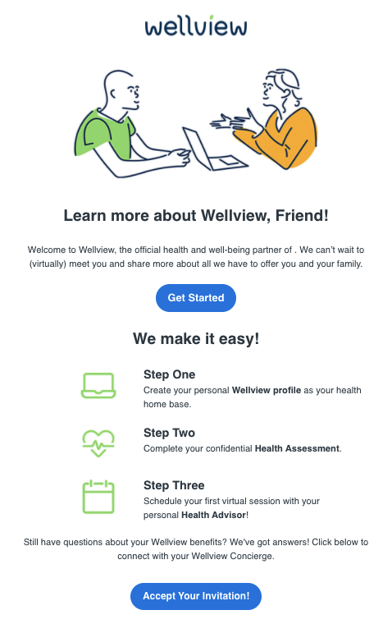
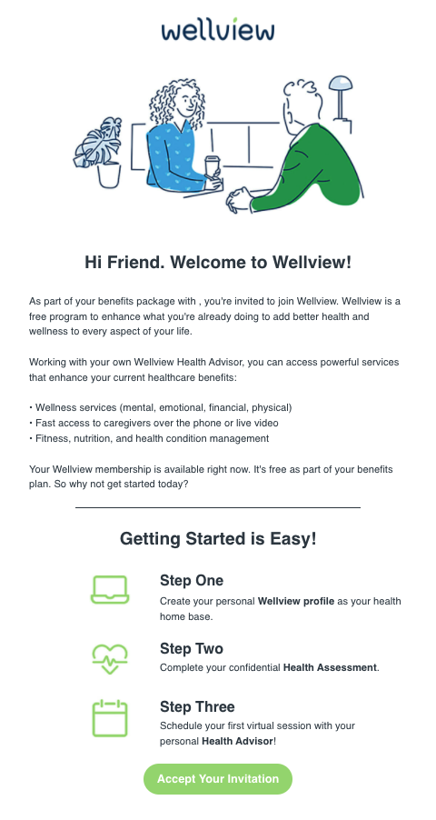
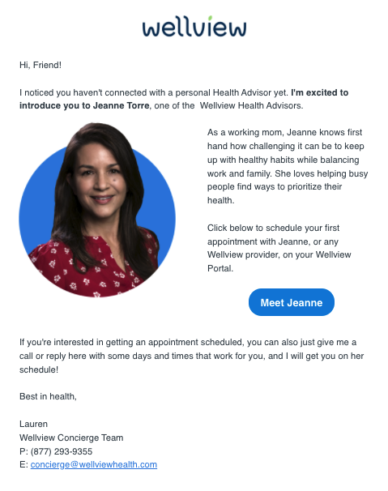
Welcome to Wellview
©2022 Wellview, Inc. – Confidential and Proprietary – Do Not Distribute

Slide 14
Wellview
Member Journey
Healthy for Life
Open to Options
For the Family
Doctor Knows Best
Live for Today
How do you approach your health?
Enroll and get started.
Diet & Nutrition
Exercise
Stress
Tobacco Use
Alcohol Use
Where are you ready to make healthy changes?
Time / Inconvenience
Resistant to Change
Environmental Factors
Illness / Injury
Motivation / Confidence
What’s keeping you from making healthier choices?
Healthy Eating
Physical Activity
Stress Management
Family & Community Relationships
Work / Life Balance
Social & Emotional Support
Quality Sleep
Discover your current state of health.
Online Health Assessment
Meet your Health Advisor
Personal Health Summary
Wellview looks at your health holistically.
©2022 Wellview, Inc. – Confidential and Proprietary – Do Not Distribute

Slide 15
Wellview
Member Journey
Create your personal Healthy Living Plan.
Guided by a Wellview Health Advisor
Create a Vision Statement
Set realistic goals and action steps
Health Advisors
Registered Dietitians
Mental Health Specialists
Personal Trainers
Certified Diabetes Educators
Put your plan into action!
Talk regularly with your Wellview Care Team for accountability and motivation. Set new goals and action steps along the way.
Chat with your Care Team
Schedule sessions to talk
Discover health resources
Invite your family to join
Track your progress
Use your Wellview Portal
We are here to support you every step of the way.
Get the help you need when you’re ready.
Best-in-Class Providers
Confidential Counseling
Prevent or Control Diabetes
Healthy Weight
Tobacco Cessation
Healthy Heart
Healthy Blood Pressure
Healthy Mom, Healthy Baby
Healthy Living Services
©2022 Wellview, Inc. – Confidential and Proprietary – Do Not Distribute

Slide 16
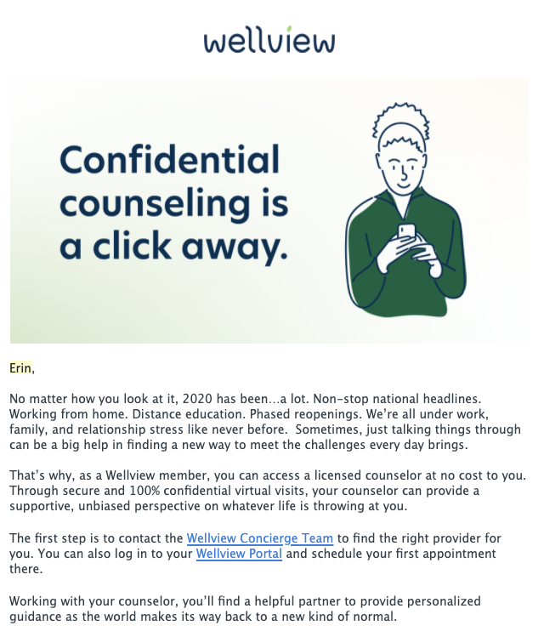
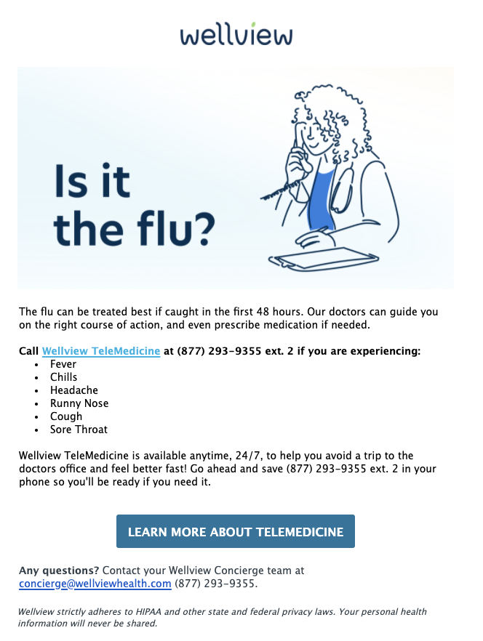
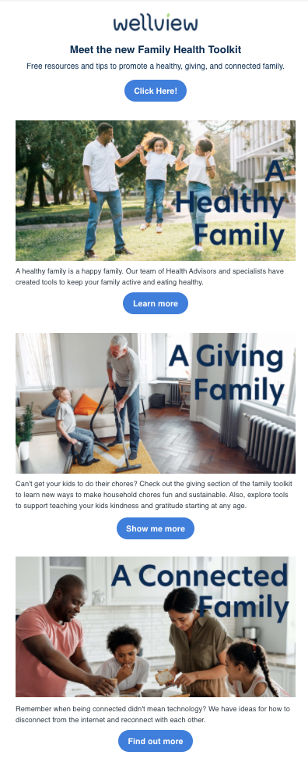
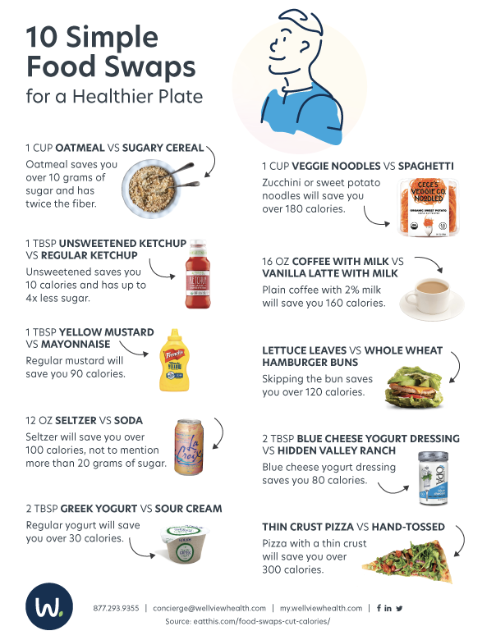
Wellview Ongoing Communications
Appointment and action-based reminders and communications
Targeted marketing using Wellview’s Care Profiling
Condition-specific engagement campaigns
Easy-to-access Family Toolkit
Monthly healthy living blogs

Slide 17
Wellview Communications Plan

Slide 18
Wellview Workshops
Our menu of workshops cover everything from nutrition and live group exercises to stress management and mental health.
Examples include:
Building Better Sleep Habits
Meal Planning and Preparation
Financial Fitness
Rethinking Exercise
Diabetes Prevention and Control
I’m Tired: Preventing Burnout
The Search for Work/Life Balance
Hosted by a Wellview Health Advisor or Specialist, workshops are tailored towards specific health concerns and interests.
©2022 Wellview, Inc. – Confidential and Proprietary – Do Not Distribute

Slide 19
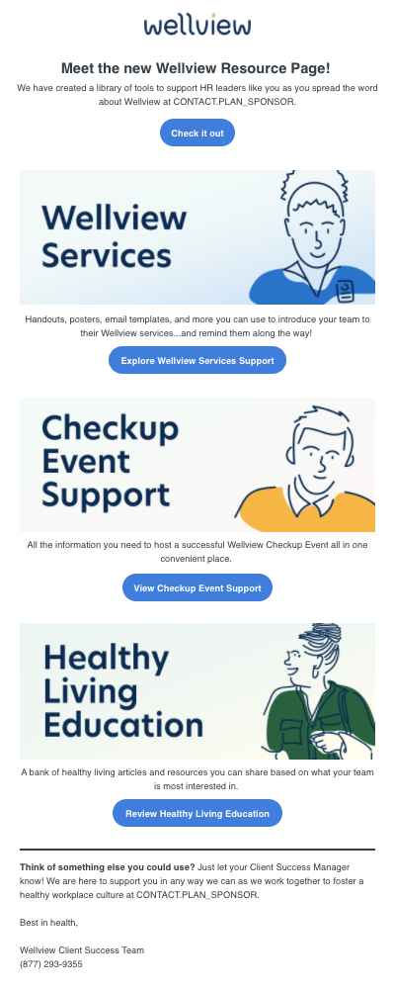
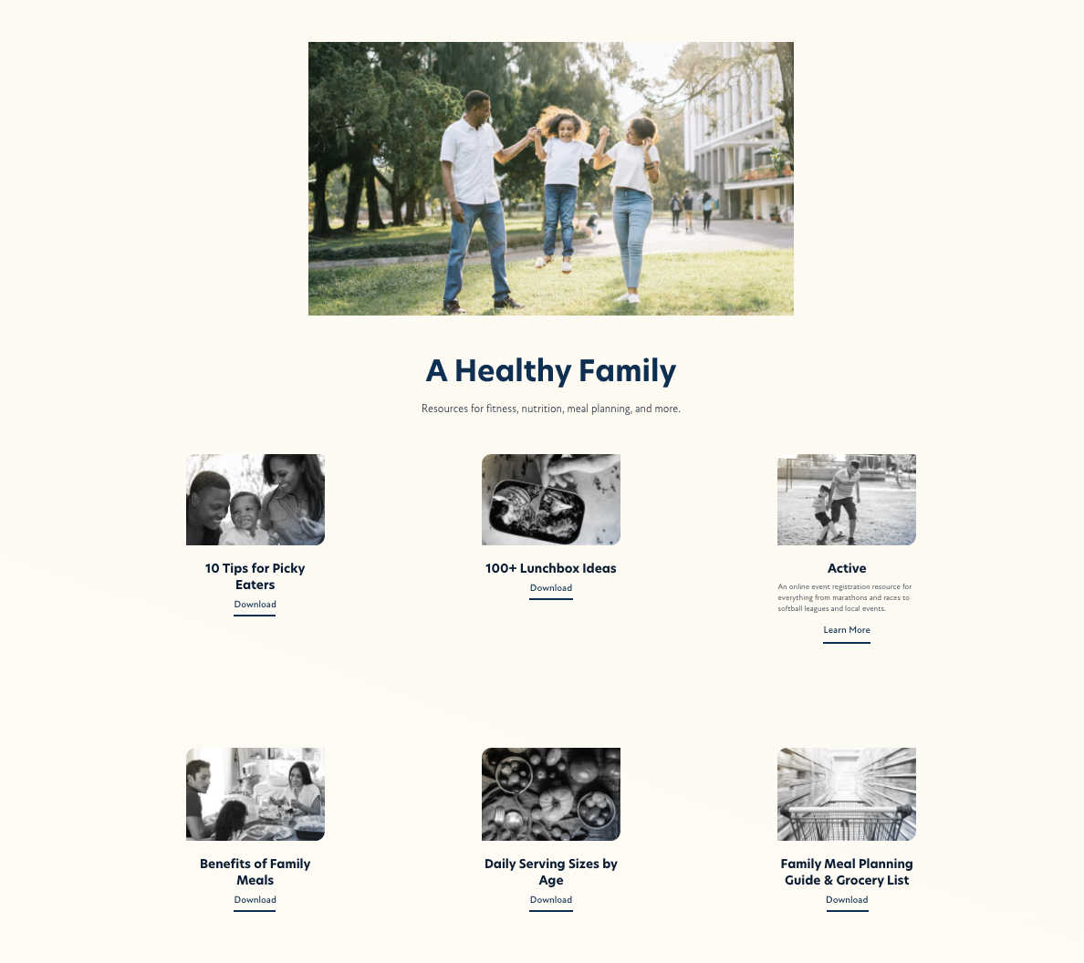
Champion Resources

Slide 20
North Carolina Bankers Incentive
Online Health Assessment
Incentive: $50
Incentive Deadline: December 31, 2022
Eligibility: Health Plan Employees
Meet with your Health Advisor for a Healthy Living Consult
Complete a follow up session with a Wellview Advisor of Specialist
©2022 Wellview, Inc. – Confidential and Proprietary – Do Not Distribute

Slide 21
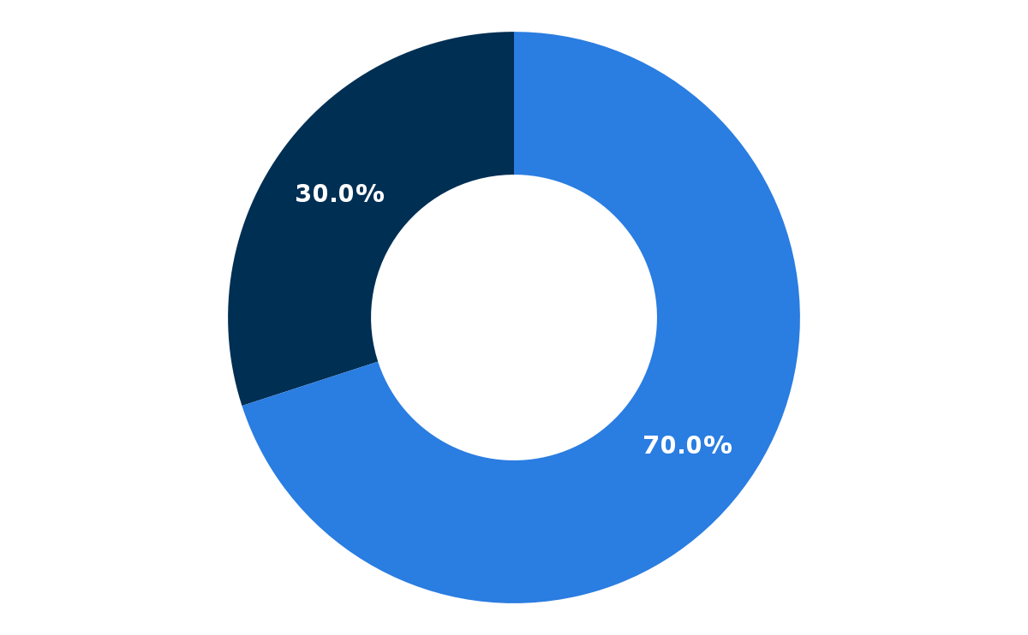
Wellview Annual Reporting | At a Glance
Wellview Awareness
Completed Appts
YTD
Top 3 Services
303
Health Advisor
Mental Health
Workshop Attendance
Registered Dietitian
57
Top 3 Health Risks
Hypertension 56%
Incentive
Achieved
Obesity 45%
Opens and clicks
No awareness
35%
Prediabetes 37%

Slide 22
Wellview Reporting Engagement Summary Breakdown
SESSION TYPE | COMPLETED APPOINTMENTS
Health Advising | 41
Registered Dietitian | 7
Certified Diabetes Educator | 3
Mental Health | 23
Personal Trainer | 12
Financial Coaching | 17
TOTAL | 103
4.9 Total Sessions per Participant
21
Total Engaged

Slide 23
Wellview is here for you with virtual support.
my.wellviewhealth.com
concierge@wellviewhealth.com 877.293.9355
©2022 Wellview, Inc. – Confidential and Proprietary – Do Not Distribute

Slide 24
Wellview
Your Wellview Team
Bethany Bishop
Client Success Manager
616.476.7501 ext. 113
bethany.bishop@wellviewhealth.com
Lauren Chapman
Client Experience Manager 877.293.9355
lchapman@wellviewhealth.com
Alyssa Graham Johnson
Director, Creative Services
615.505.1001
ajohnson@wellviewhealth.com
©2022 Wellview, Inc. – Confidential and Proprietary – Do Not Distribute

