Slide 1
Curriculum Overview Guide

Slide 2
Curriculum Contents:
Lesson Plan & Basic Timeline
NCEL Dollar Decisions Directions
NCEL Dollar Decisions Board (will need copies for participants)
NCEL Dollar Game Cut Outs (may need add ’l copies)
NCEL BIS Curriculum (will need copies for participants)

Slide 3
Budgets 101 Lesson Plan & Timeline:
5 Minutes: Introduction of Bankers and Purpose for Visit
15 Minutes: Dollar Decisions Game (set up & play)
20 Minutes: Game Debrief/Review Handout
Important Terminology
Concepts in Action
Calculating Future Expenses
Budget
Creating a Personal Budget (if time allows)
5 Minutes Conclusion

Slide 4
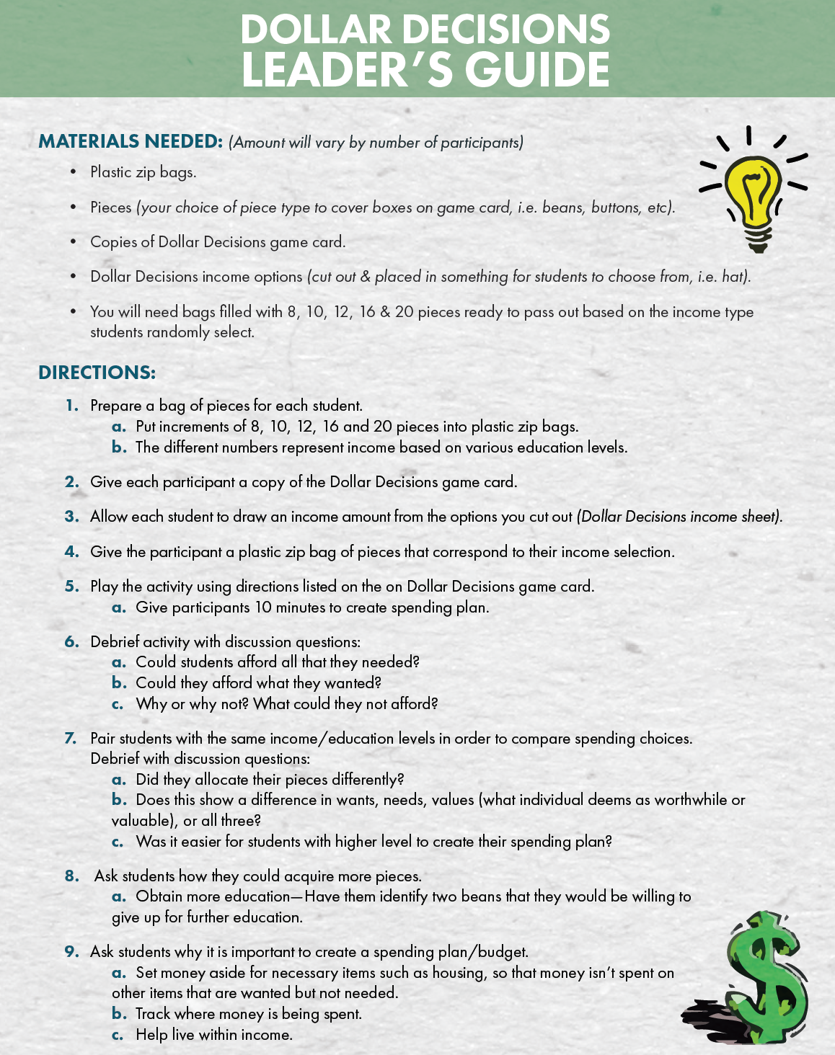

Slide 5
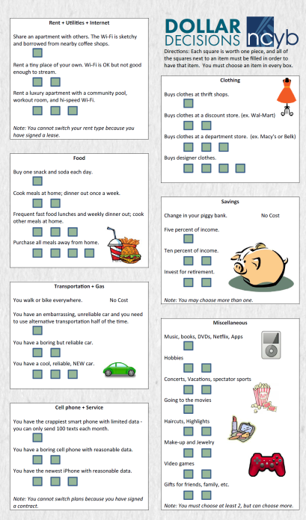
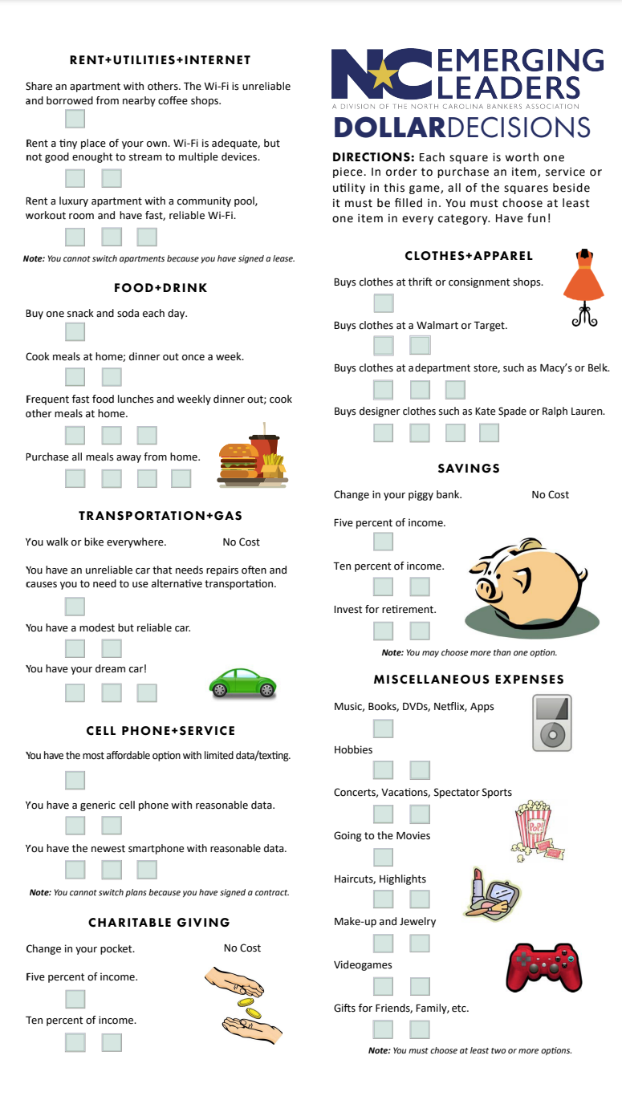
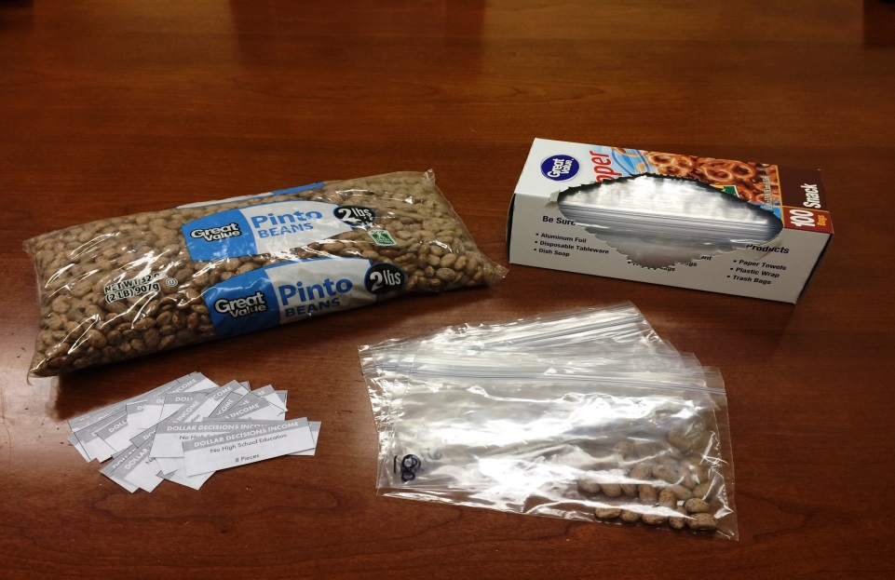
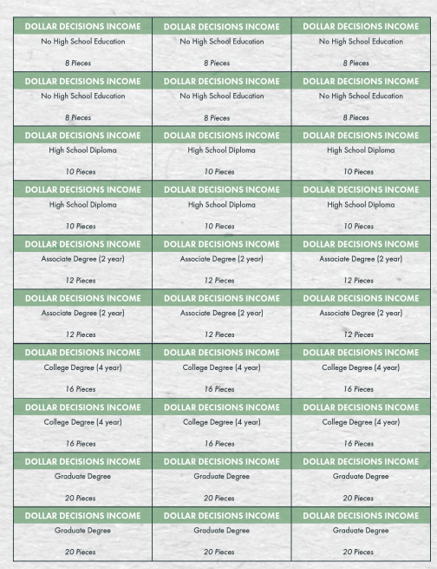
Materials Needed: (Amount will vary by number of participants) - Plastic zip bags - Pieces (your choice of piece type to cover boxes on game card i.e. beans, buttons, etc.) - Copies of Dollar Decisions game card - Dollar Decisions income options (cut out & placed in something for students to choose from i.e. hat) - You will need bags filled with 8, 10, 12, 16 & 20 pieces ready to pass out based on the income type students randomly select

Slide 6
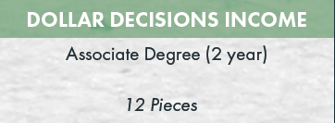
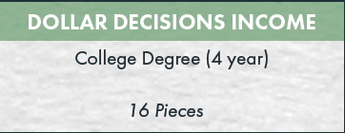
Directions:
1. Prepare a bag of pieces for each student.
Put increments of 8, 10, 12, 16 and 20 pieces into plastic zip bags.
The different numbers represent income based on various education levels.

Slide 7
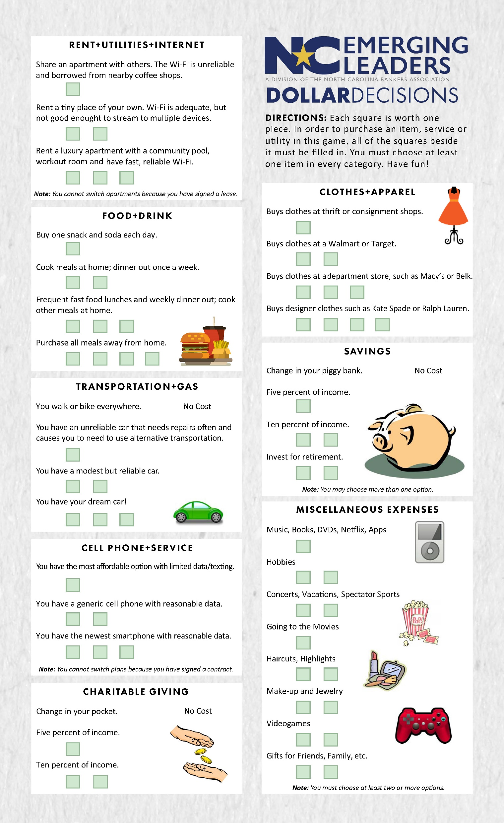
Directions:
2. Give each participant a copy of the Dollar Decisions game card.
Print game cards on legal paper

Slide 8
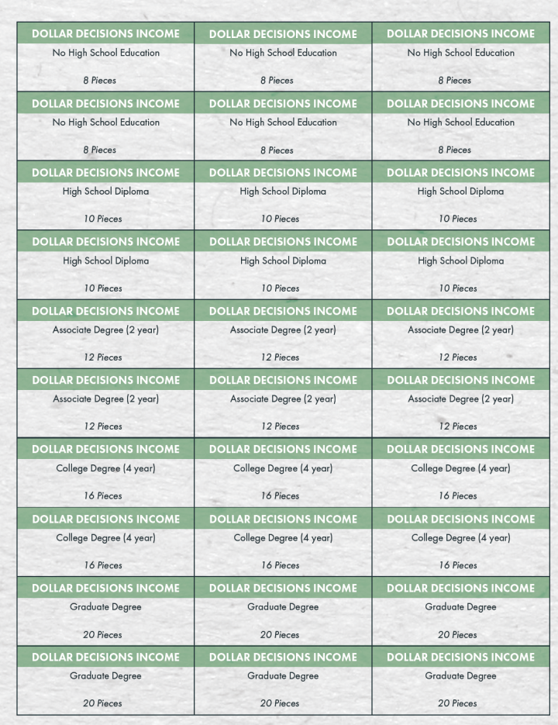
Directions:
3. Allow each student to draw an income amount from the options you
cut out.

