Slide 1
Directions:
4. Give the participant a plastic zip bag of pieces that correspond to their
income selection.

Slide 2
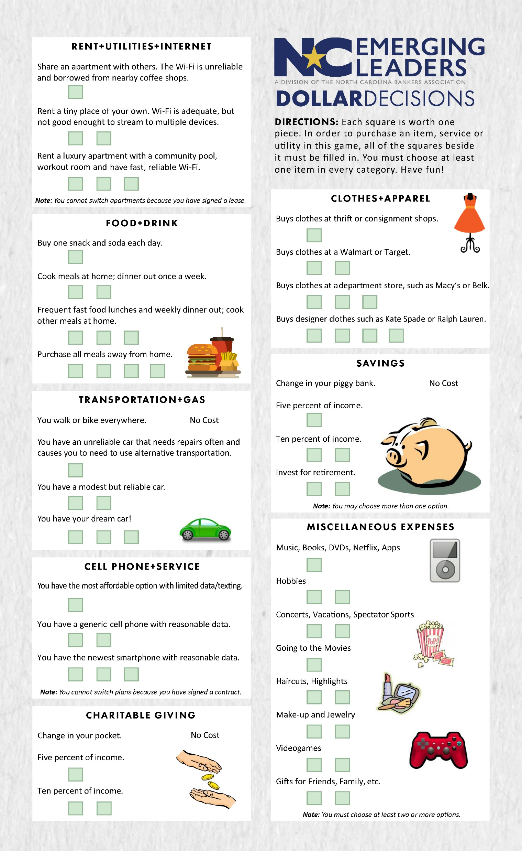
Directions:
5. Play the activity using the directions listed on the Dollar Decisions
game card.
Give participants 10 minutes to create spending plan.

Slide 3
Directions: 6. Debrief activity with discussion questions a. Could students afford all that they needed? b. Could they afford what they wanted?

Slide 4
Directions: 7. Ask students how they could acquire more pieces. a. Obtain more education—have them identify two beans they would be willing to give up for further education.

Slide 5
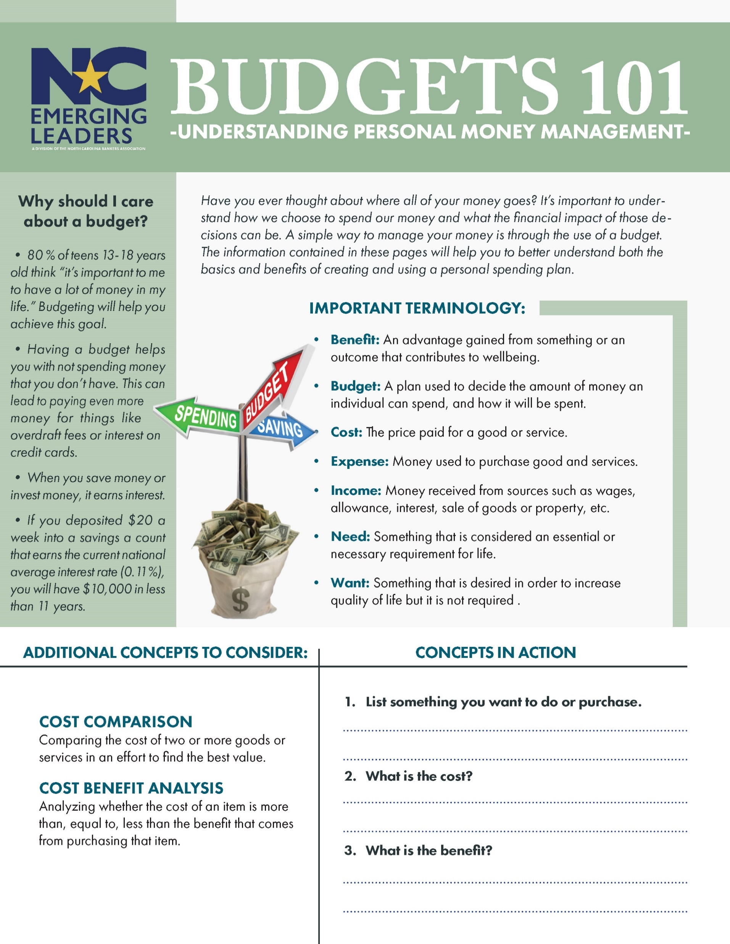

Slide 6
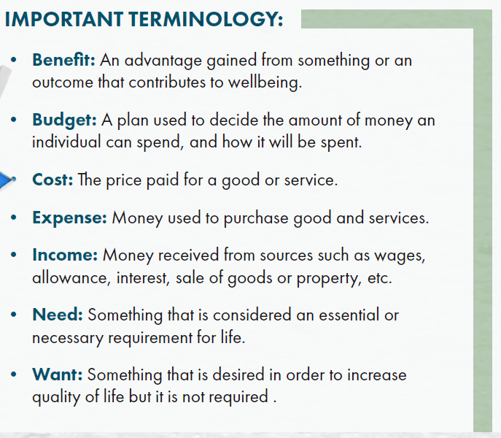
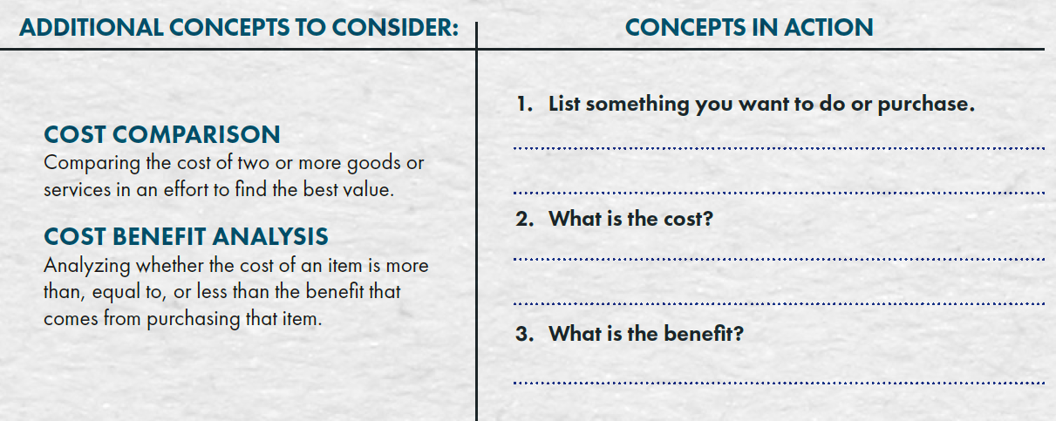

Slide 7
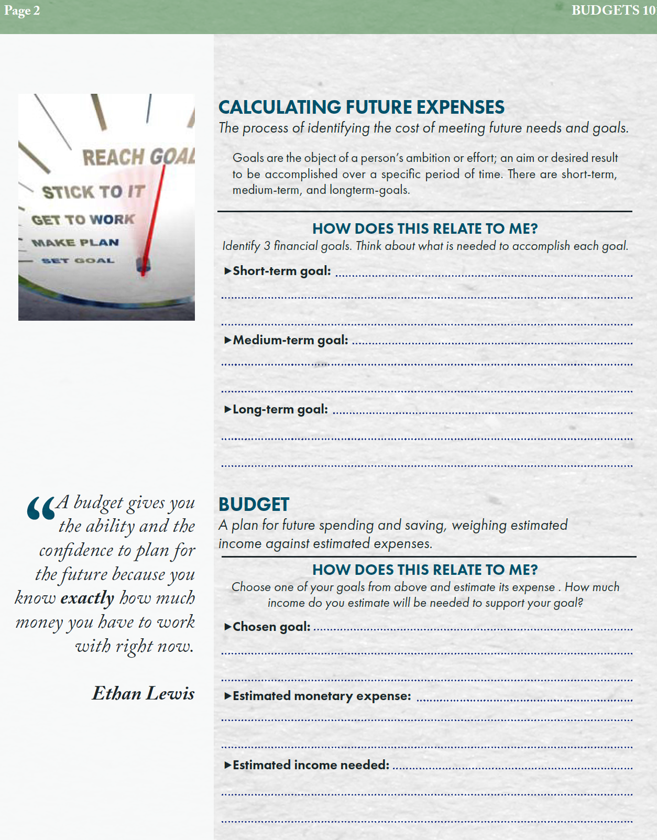

Slide 8
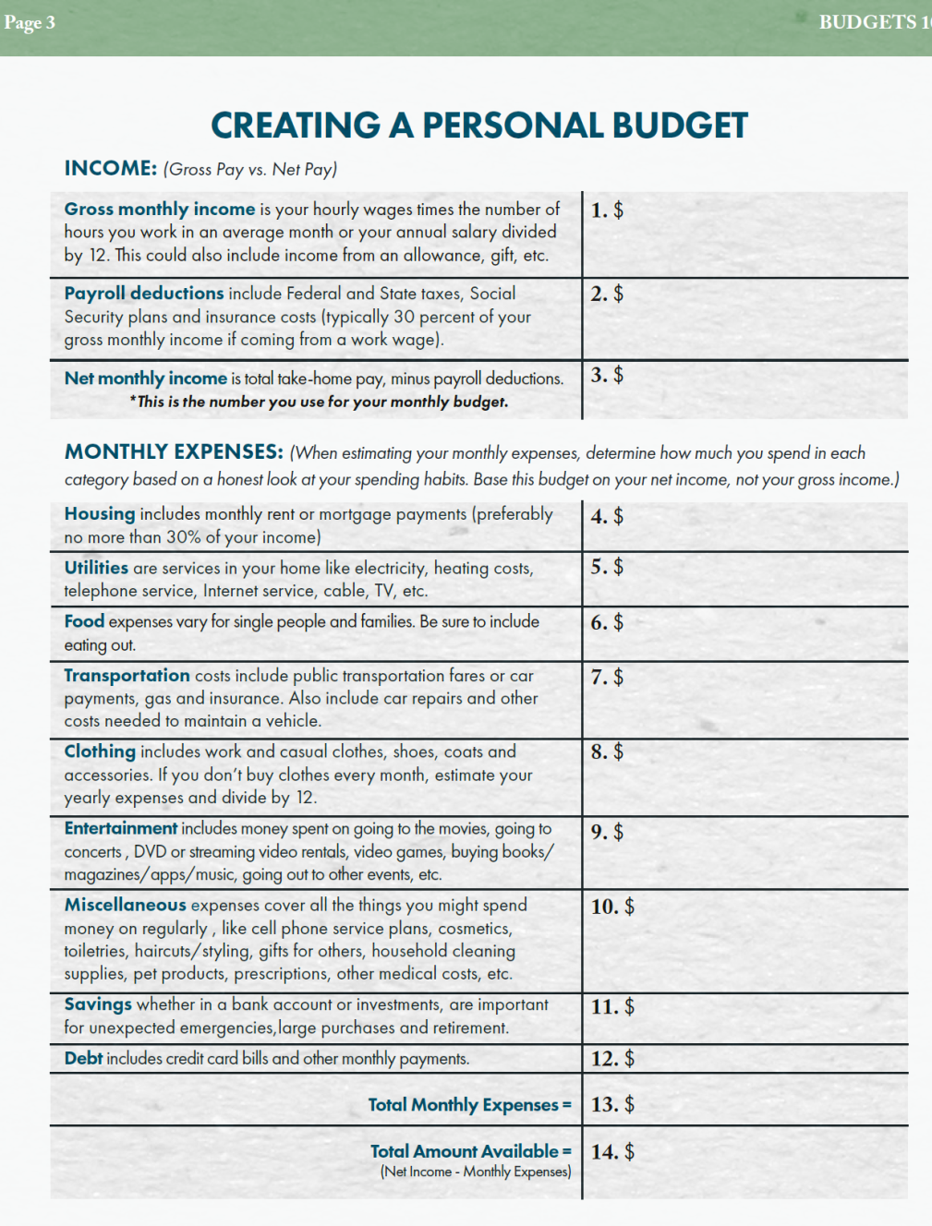

Slide 10
Closing Thoughts:
Please contact your region’s NCYB representative for any additional questions.
East: Rickman Davis, Live Oak Bank (rickman.davis@liveoakbank.com)
Will Johnson, Southern Bank & Trust (will.johnson@southernbank.com)
Bryant Pope, First Federal Bank (bpope@ffbnc.com)
Harrison Sweat, Lumbee Guaranty Bank (harrisonsweat@lumbeeguarantybank.com)
Triangle: Natanya Chadwick, Pinnacle Financial Partners (natanya.chadwick@pnfp.com)
McKenna Gorham, NCBA (mckenna@ncbankers.org)
Jumeekah Ingram, First Carolina Bank (jumeekahingram@firstcarolinabank.com)
Laura Keefer, Southern First Bank (lkeefer@southernfirst.com)
Ryan Morgan, North State Bank (rmorgan@northstatebank.com)
Ingrid Nelson, First Carolina Bank (ingridnelson@firstcarolinabank.com)
Jack Scott, Dogwood State Bank (jscott@dsbnc.com)
Beth West, First Carolina Bank (bethfite@firstcarolinabank.com)
Charlotte Metro: Hillary Kestler, First Bank (hkestler@localfirstbank.com)
Robert Peterkin, Bank of America (robert.peterkin@bofa.com)
Dane Robinson, Peoples Bank (crobinson@peoplesbanknc.com)
West: Lacy Cross, Movement Bank (lacy.cross@movementbank.com)
Elise Penland, HomeTrust Bank (elise.penland@htb.com)
Mitzi Reed, First Citizens Bank (foureeds@gmail.com)
Triad: Erin Bennett, Carter Bank and Trust (erin.bennett@cbtcares.com)
Paul Carney, Carter Bank & Trust (paul.carney@carterbankandtrust.com)
TC Hinkle, Piedmont Federal Savings Bank (tchinkle@piedmontfederal.com)
Jordan Morgan, Bank of America (jordan.p.morgan@bofa.com)
Matt Zacharias, Triad Business Bank (mzacharias@triadbusinessbank.com)

Slide 11
Additional Resources
Official Bankers in Schools Resources:
Budgets 101 Lesson Plan
Training Video
NCEL Dollar Decisions Leader’s Guide
NC Emerging Leaders Dollar Decisions Board
BIS Income Level Cards
Bankers in Schools Curriculum – Supplemental material to Dollar Decisions
Outside Resources:
ABA “Youth & Money”: https://www.aba.com/advocacy/community-programs/consumer-resources/kids-money#b540b64180a44dcd9adb97eecde873ba
Bank of America “Better Money Habits”: https://bettermoneyhabits.bankofamerica.com/en/gen-z-financial-habits
FDIC “Money Smart for Young People”: https://www.fdic.gov/resources/consumers/money-smart/teach-money-smart/money-smart-for-young-people/index.html

