Slide 1

LOANS TO "SMALL" BUSINESS
Mike Comer
Retired Banker
Sevierville, TN

Slide 2
The “Art”…….
Vs.
The “Science”

Slide 3

What is a “Small Business”?

Slide 4
Definition of a “Small Business”
Size
  $500M to $15MM in annual sales

Slide 5

Advantages to a Bank
Customer for life … loyalty
Cross-sell Opportunities
Somewhat limited competition from other financial resources
May be more profitable

Slide 6
Disadvantages to a Bank
Limited resources (i.e. changes to competition, economy, financial conditions, etc.)
Unsophisticated
Minimal Management Depth
Competition may be increasing

Slide 7
“Start-Up” Business
“Less than 3 years operations”
You are really a “Pawn Broker”
More dependent on collateral
  A/R, Inv., etc. = “Unsecured”
Unproven CASH FLOW
Very risky!!!

Slide 8
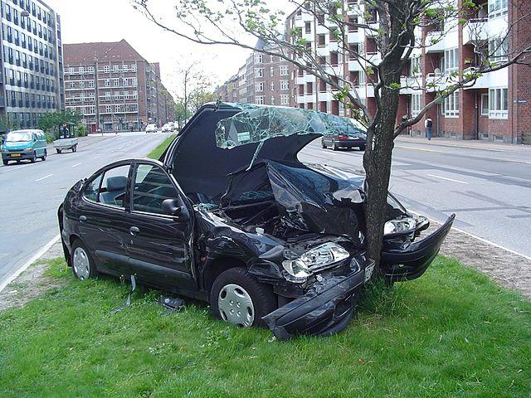
According to the U.S. Bureau of Labor Statistics, the failure rate for new businesses is:
First two years: Around 20% of new businesses fail
First five years: Around 45% of new businesses fail
First 10 years: Around 65% of new businesses fail
15 years or more: Only 25% of new businesses make it to this point

Slide 9
Existing Business
Is CASH FLOW adequate to service all debt … not just the loan you’re considering
  “Global Cash Flow”
Still risky …
Must analyze requests … no “good ole boy” lending

Slide 10
LOAN PACKAGE OUTLINE

Slide 11

Article
“How to write a Loan Proposal.”
See your Notebook

Slide 12
“Forecasts may tell you a great deal about the forecaster; they tell you nothing about the future.”
Warren Buffett

Slide 13

Decision Strategy
Summarize any actions required of your audience
Summarize any follow up action items required of you

Slide 14
Interview/Call
What is the specific request?
Is the request legal and within bank policy?
Are terms logically related?
Is the loan purpose highly speculative?
Learn about the business and management!
If possible, obtain financial information in advance.

Slide 15

Arriving at a Credit Decision

Slide 16

Three Types Of Financial Statements Prepared by CPA’S

Slide 17
Compilation
General understanding of the nature of the business.
Knowledge of forms of accounting records
Know qualifications of the accounting personnel and procedures.
Will Not:
  Verify, corroborate or review info.
  Give an any opinion

Slide 18
Review
General knowledge of the industry
Enough knowledge of the business procedures to express limited assurance that no modifications should be made to statement to conform to GAAP.
General understanding of the business organization and operating characteristics.

Slide 19
Review
Will:
  Inquires into accounting principles, practices, methods of applications, procedures for classifying transactions and information accumulated for disclosure.
  Thorough check of unusual transfers.
No opinion

Slide 20

Audit
Perform same tests as in “Compilation” and “Review” and verify the content of each account.
Types:
  Unqualified
  Qualified

Slide 21
Financial Statements
Who prepared them? Internal vs. Accountant vs. CPA
Historical information
  3 to 5 years of financial statements
  Interim financial statements

Slide 22

ANALYSIS
Primarily for a “Dynamic Balance Sheet”
Notes:
*
‹#›

Slide 23
Liquidity - A measure of the quality and adequacy of current assets to meet current obligations as they come due.
Working Capital
Current Ratio
Account Receivable Turnover (Days)
Inventory Turnover (Days)
Accounts Payable Turnover (Days)

Slide 24
Working Capital
Current Assets minus Current Liabilities
As Working Capital exceeds inventory, liquidity increases
If inventory is greater than Working Capital, inventory must be sold in order to meet current obligations.

Slide 25
Current Ratio
  Total Current Assets
  Total Current Liabilities
  A rough indication of a firm’s ability to service it’s current obligations
  The higher the Current Ratio, the greater the “cushion” between current obligations and a firm’s ability to pay them.

Slide 26
The higher the Current Ratio, the greater the superiority of Current Assets over Current Liabilities.
  Beware of the quality of Assets
    Accounts Receivable
    Inventory
    “Investments”
    “Other” Receivables

Slide 27

Accounts Receivable Turnover (Days)
____________365__________ Net Sales/Accounts Receivable
Indicates the average time , in days, that receivables are outstanding.
The greater number of days outstanding, the greater the probability of delinquencies in account receivable.

Slide 28
A measure of management’s effectiveness over credit and collections …… how good of a banker is your customer???
Different terms vary among industries and must be taken into consideration …… RMA Statement Studies
Measures only one point in time
Limitations include a consolidation (summary) of A/R information …… Aging of A/R?????

Slide 29

Inventory Turnover (Days)
_________365_____________
Cost of Sales/Inventory
Indicates the average length of time units are in inventory.
The higher the number of days can indicate poor liquidity, possible overstocking, obsolescence and signals of poor management
… on the other hand, could be a planned inventory build-up preparing of material shortages.

Slide 30
The lower the number of days can indicate better liquidity or superior merchandising
… or it may indicate a shortage of needed inventory for sales.
Different terms vary among industries and must be taken into consideration
… RMA Statement Studies

Slide 31
A problem with this ratio is that it compares one day’s inventory to Cost of Goods Sold and does not take seasonal fluctuations into account (i.e. timing)
Always ask more questions … “penetrate the credit”

Slide 32
Accounts Payable Turnover (Days)
____________365___________ Cost of Goods Sold/Trade Payables
Indicates the average length of time trade payables are outstanding
The higher the number of days can indicate cash shortages, disputing invoices with suppliers
… or enjoying extended terms or deliberately expanding trade credit

Slide 33
The lower the number of days indicates shorter time between purchase and payment
A problem is that it compares one day’s Payables to Cost of Goods Sold and does not take into consideration seasonal fluctuations … ask more questions
Banks can ensure that companies are taking advantage of Trade Credit
… spreads/lessens the risk

Slide 34
Trade Discounts
What does “2/10 net 30” mean???
Discount Rate(360) Net Days - Discount Period
0.02 (360)
30 - 10
36%
  Wow! I think you could do a little better?????????????????????

Slide 35
Leverage - A measure of vulnerability to business downturns. This varies greatly depending on the requirements of a particular industry group.
Debt/Worth
Total Liabilities
Net Worth
Expresses the relationship between capital contributed by creditors and by owners.
  The higher the ratio, the greater the risk assumed by creditors … limited debt capacity
  The lower the ratio, the greater prospects for long-term financial safety … more flexibility to the borrower

Slide 36
Operating Ratios - Assist with the evaluation of management’s performance.
Sales/Assets - A measure of a firm’s ability to generate sales relative to asset size
  Use only comparable industry groups
Net Profits/Sales (Net Profit Margin) - Measures operating efficiency
  Use only comparable industry groups

Slide 37
Margin Analysis - The relationship of various components of the Income Statement to Total Sales
Gross Margin
- Business profits after Cost of Goods Sold
- Are direct costs being adequately covered???
Selling , General and Administrative Expenses
- Most important expense control area
- Measures management’s ability and cost control

Slide 38

CASH FLOW
“Cash is King!!!”
Accounts Receivable
Dec. is a Source, Inc. is a Use
Inventory
Dec. is a Source, Inc. is a Use
Accounts Payable
Dec. is a Use, Inc. is a Source
Gross Margin
Dec. is a Use, Inc. is a Source
Selling, General and Administrative Expenses
Dec. is a Source, Inc. is a Use

Slide 39
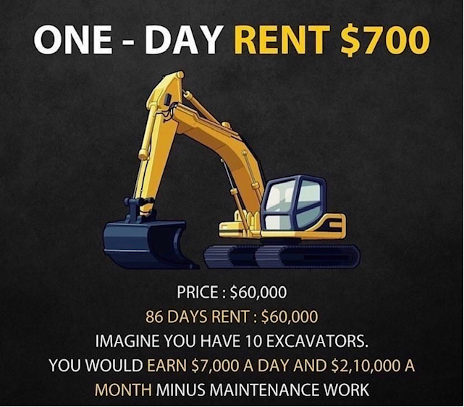
What is wrong with this picture?

Slide 40

Trends To Watch
Sales/Revenues
Net Profits
Cash
Debt
Net Worth
Total Assets
All Elements of Cash Flow

Slide 41
Trends To Watch
See “The Two Minute Drill”
Part of the Online material.
Notes:
*
‹#›

Slide 42
Ways To Interpret Ratios
The ratio alone
Trends
Industry Average
  RMA Statement Studies
  North American Industry Classification System (NAICS)

Slide 43
Forms Of Business
Sole Proprietorship
Partnership
- General
- Limited
Limited Liability Company
Corporation
- Sub-chapter S
- Closely Held vs. Widely Held

Slide 44
References
Know Your Borrower!!!
  Personal Credit Report of Guarantors
  Suppliers/ Trade Creditors
  Their Customers
  Other Bankers?????
    No one will use “bad” references
    Remember, if your borrower is a crook, they will get you!!!!!!

Slide 45
Management
Experience - Education - “On-the-Job”
Depth

Slide 46
Business/Industry
Economy
- Local
- National
Trends
Cyclical or seasonal business??
Competition

Slide 47

Site Visit
Always inspect your collateral! - Appraisals
- “Lower cost or market”
Company Appearance
Employee attitude and moral
Inventory “Condition”
Condition of Equipment

Slide 48

Structure and Administration of Loans

Slide 49
Loan Terms
Does the repayment schedule match the borrowing cost???
  Unsecured Debt should be able to be amortized over 3 years.
  Finance for the “life” of the asset being purchased
    Equipment - 5 years or less
    Real Estate - 15 to 20 years
    Seasonal Borrowings - 1 year or less (I.e. Lines of Credit)

Slide 50

Personal Guarantees
All major owners
- 20% or more
If there’s not going to be a problem, why not…
Personal Financial Statements
  How much of their income and Net Worth is in the company?
  Contingent Liabilities???

Slide 51
  Don’t expect this to be a source of repayment
- You’ll have to sue to get your money
  What if they transfer assets???

Slide 52
Government Loan Guarantees
Reduces exposure to the bank
Documentation is vital!!!!
Time consuming
You must monitor covenants, requirements and conditions
Guaranteed portion is “sellable” on the Secondary Market.

Slide 53
Small Business Administration (SBA)

Slide 54
United State Department Agricultural (USDA)

Slide 55
Loan Covenants
Commitment Letter
Loan Agreement
  What a Loan Agreement is…
    When a note is not enough (complex)
    Establishes intent for future interpretations
    Defines expectations of parties involved
    Part of the package

Slide 56
  What a Loan Agreement is not…
    Provide security
    Repay the loan
    Improve management
    Make the company successful
    Substitute for proper credit analysis
    Improve credit quality

Slide 57
Loan Agreement
Amount of the Loan
Maturity
Interest Rate
Repayment Schedule
Purpose
Security
Payment of the Loan
Parties
Changes in the business

Slide 58
Loan Agreement (Cont.)
Affirmative Covenants
  Balance Sheet Requirements
  Submission of Financial Statements
  Insurance
  Specific Payments
  Notification of change in Condition of the Business

Slide 59
Loan Agreement (Cont.)
Negative Covenants
  Debt Incurrence
  Pledged Assets
  Salaries/Dividends
Default Provisions

Slide 60
Commitment Letter Review
Examples to be provided
Consult your local legal counsel.

Slide 61
Term Sheet
This is NOT a Commitment and
may it be used to “shop” your deal?
Amount of the Loan
Maturity
Interest Rate
Repayment Schedule
Purpose
Security
Payment of the Loan
Parties
Notes:
*
‹#›

Slide 62
Insurance
Always require Hazard Insurance for all collateral
Life insurance
Disability Insurance - Often overlooked
If you require it, monitor it...

Slide 63
Servicing/Monitoring
Financial progress - Annual personal and company financial statements
Loan Review … Your Friends
Correct documentation
Compliance with covenants
Financial condition
Payment of taxes, insurance, payables, etc.

Slide 64

Business Life Cycle
Introduction
Growth
Maturity
Decline

Slide 65

CASE STUDY
“Foods For Life”

Slide 66
Did you do your homework?????
Review the Case.
What is the legal structure or this business? Why do you think the chose this structure?
What type of business is this? Explain.
In what stage of the business life cycle is this business? What characteristics indicate this stage?

Slide 67
What caused the need to borrow? How can you determine this need from the financial statements?
What is the probable use of the loan proceeds?
What do the financial statements tell you about the management of the company?
Is the likely term of a loan made to Foods For Life long or short term? Explain.
- What if they asked for a “90 Day Note”?

Slide 68
FOODS FOR LIFE
INCOME STATEMENT
For the Years Ended:

Slide 69
 | XXX1 | XXX2 | XXX3
Net Sales | $1,854,200 | $2,503,168 | $3,529,468
Cost of Goods Sold | 1,372,108 | 1,807,120 | 2,629,148
GROSS PROFIT | $482,092 | $696,048 | $900,320
Operating Expenses:
Selling Expense | $17,940 | $23,584 | $38,052
General & Admin. Expense | 62,592 | 85,240 | 135,760
Lease/Rent Expense | 12,000 | 17,000 | 27,140
Depreciation | 15,260 | 17,304 | 28,532
Personnel Expense | 280,200 | 366,100 | 503,940
TOTAL OPERATING EXPENSES | $387,992 | $509,228 | $733,424
OPERATING INCOME | $94,100 | $186,820 | $170,364
Other Income | $0 | $2,512 | $3,468
PROFIT BEFORE INCOME TAX | $94,100 | $189,332 | $170,364
Income Tax | $17,876 | $31,212 | $39,420
NET INCOME | $76,224 | $158,120 | $130,944
Notes:
*
‹#›

Slide 70
FOODS FOR LIFE
BALANCE SHEET
For the Years Ended:

Slide 71
 | XXX1 | XXX2 | XXX3
Current Assets:
Cash | $38,048 | $17,644 | $5,092
Accounts Receivable | 223,356 | 302,648 | 430,364
Inventory | 293,132 | 398,952 | 554,544
TOTAL CURRENT ASSETS | $554,536 | $719,244 | $990,000
Other Non-Current Assets: Prepaid Exp. Other Assets TOTAL NON-CURRENT ASSETS Fixed Assets: | $24,072 17,316 $41,388 | $28,412 24,080 $52,492 | $31,584 33,332 $64,916
Leasehold Improvements | $56,620 | $66,244 | $80,156
Machinery & Equipment | 137,092 | 167,252 | 217,424
(Less: Accumulated Depreciation) | (35,260) | (52,564) | (81,096)
TOTAL FIXED ASSETS | $158,452 | $180,932 | $216,484
TOTAL ASSETS | $754,376 | $952,668 | $1,271,400
Notes:
*
‹#›

Slide 72
 | XXX1 | XXX2 | XXX3
Current Liabilities:
Accounts Payable | $97,564 | $184,176 | $351,368
Note: Bank | 0 | 0 | 12,700
Accrued Taxes | 8,520 | 11,756 | 35,468
Other Accruals | 19,892 | 33,216 | 17,400
TOTAL CURRENT LIABILITIES | $125,976 | $229,148 | $416,936
Capital:
Capital Stock | $200,000 | $200,000 | $200,000
Retained Earnings | 428,400 | 523,520 | 654,464
TOTAL CAPITAL | $628,400 | $723,520 | $854,464
TOTAL LIABILITIES & CAPITAL | $754,376 | $952,668 | $1,271,400
Notes:
*
‹#›

Slide 73
FOODS FOR LIFE
Trends
 | XXX1 | XXX2 | XXX3
Sales | $1,854M | $2,503M | $3,529M
Net Profit | 76M | 158M | 131M
Cash | 38M | 18M | 5M
Total Assets | 754M | 953M | 1,271M
Net Worth/Capital | 628M | 724M | 854M
Working Capital | 429M | 490M | 573M
WC/Inv. | 1.4 | 1.2 | 1
Sales Growth | N/A | 35% | 41%
Notes:
*
‹#›

Slide 74
FOOD FOR LIFE
Analysis
NAICS 333999 …
Manufacturing
(Median Value)
XXX1 XXX2 XXX3 RMA
Gross Margin 26% 27.81% 25.51% 33.5%
SG&A 20.10% 19.65% 19.97% 29.1%
Receivables Days 44 44 45 46
Inventory Days 78 78 77 60
Payables Days 26 36 49 27
Current Ratio 4.40 3.14 2.37 2.1
Debt/Worth 0.20 0.32 0.49 1.1
WC/Inv. 1.4 1.2 1 -----
Quick Ratio 2.08 1.40 1.04 1.1
**Note: Current Ratio less Inventory & Prepaid Exp.
Notes:
*
‹#›

Slide 75
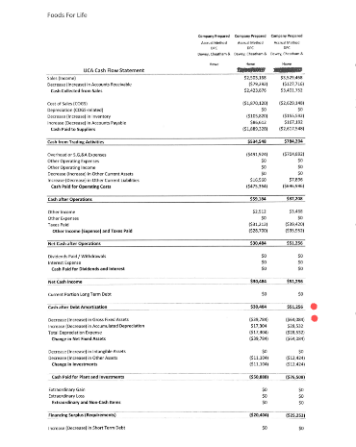

See Online materials
Notes:
*
‹#›

Slide 76
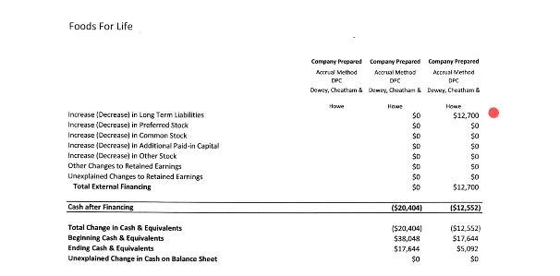
See Online materials
Notes:
*
‹#›

Slide 77
State three strengths of the credit
State three weaknesses of the credit
What financial ratios would you utilize in analyzing the credit-worthiness of this request?
What additional information, if any, would you request?
Would you recommend approval? - If so, what is your proposed loan structure?

Slide 78
And now what…?
Did you approve a $120,000.00 loan?
Notes:
*
‹#›

Slide 79
IF…….
Accounts Payable (Days) =
  365 Days/(Cost of Goods Sold / $A/P)
Then……
$A/P = Target A/P Days (COGS)/365
    Actual – 49 Days vs. RMA – 27 Days
  $A/P = 27 ($2,629,148) / 365
  $A/P = $194,485
$351,368 A/P resulting in 49 Days
-194,485 A/P required to achieve 27 Days
$156,883 additional Capital required!!!
Notes:
*
‹#›

Slide 80
You provided a loan of only $120,000
$351,368 Current A/P
- 120,000 New Permanent Working Capital Loan
$231,368 Adjusted A/P
A/P Days = 365 Days/(Cost of Goods Sold / $A/P)
A/P Days = 365 / ($2,629,148 / 231,368)
A/P Days = 32
Improved from 47 to 32 days, but not to the RMA 27 days
Seems to “work”, for now …….
  What about growth?
Notes:
*
‹#›

Slide 81
Projections?????
Sophisticated
Wild
Ass
Guess
Remember the Warren Buffett quote….

Slide 82

Why Businesses Fail?!

Slide 83
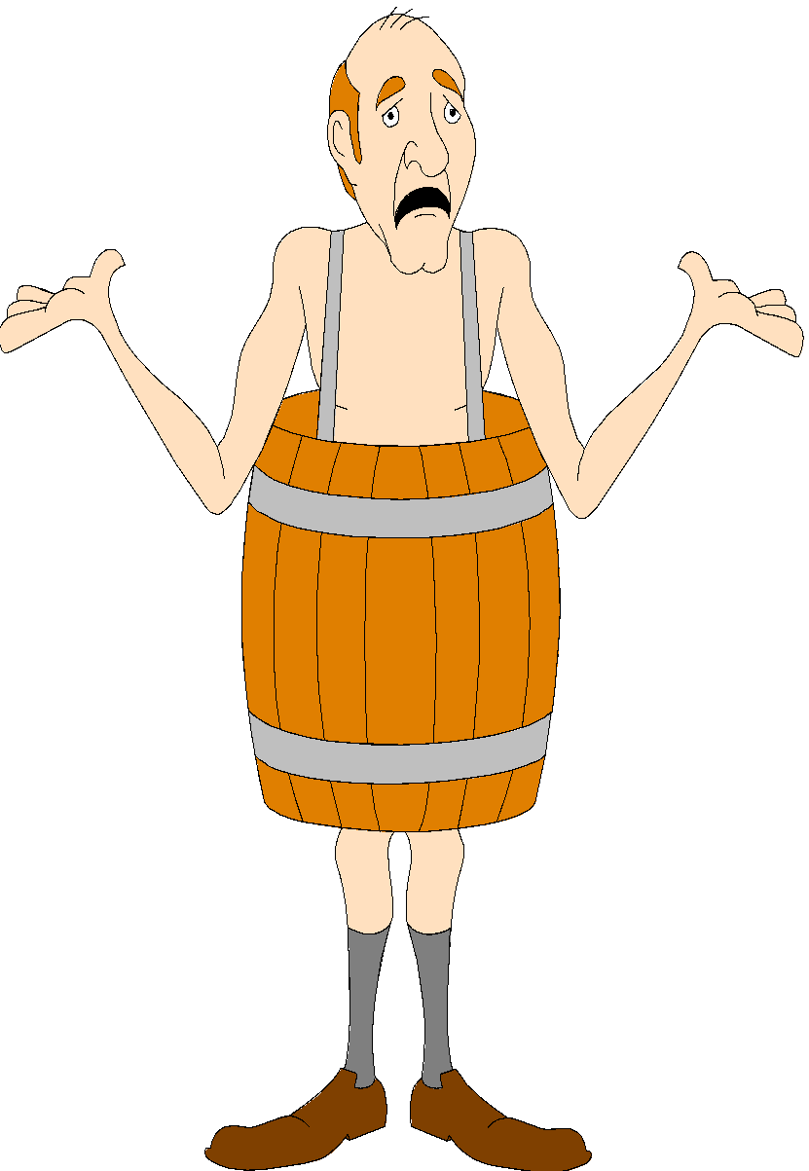
Early Warning Signs
Cash Management - Overdrafts
- Uncollected Funds usage or Kiting
- Inadequate cash flow
* Line of Credit usage
* Loans or requests
Changes in key management personnel

Slide 84
Late financial statements or other information
Change in accountants
Litigation
Loan Agreement violations
Marked increase in Trade Credit inquiries
- “COD”
You get a “feeling” that something is not right

Slide 85

Causes For Business Failures

Slide 86
There are said to be 13 causes for business failures as follows. One cause (#13) is the only one in which managerial incompetence, inexperience, and/or neglect plays little or no part.
Poor Balance Sheet proportions reflected by:
  Excessive liabilities brought on by:
    Over trading
    Losses or depletion of working capital
  Heavy fixed assets brought on by:
    A desire to increase manufacturing facilities
    A desire to enlarge or improve appearance in the retail units.
    Continued losses reducing New Worth to a low level in relation to fixed assets

Slide 87
Cont.
  Excessive Inventories caused by:
    Speculation, poor judgment of markets
    Over buying or poor styling
    Pricing too high to be competitive
  Heavy receivables due to inefficient credit and collection policies
  Excessive investment and advances to affiliated concerns which operate unprofitably or become “financially embarrassed”
  Excessive loans to officers, directors and/or employees
  Excessive investment in other “slow assets”

Slide 88
Cont.
Weakness Reflected in the Income Statement:
  Declining sales causing operating losses
    Under Trading
  Excessive fixed charges
  Continuous operating losses
  Excessive Officer’s Salaries, Withdrawals or Dividends

Slide 89
Cont.
Beyond Human Control
  Disasters that are not avoidable
    Floods
    Tornados
    Earthquakes

Slide 90

Qualities Of A Successful Lending Officer

Slide 91
Effective Communication Skills
Attention to Details
Ease in Dealing in Numbers
Ability to Negotiate
Maturity
Integrity
Adaptability
Sense of Humor
Tough-Mindedness
Student of Human Nature
Sales Ability
Intelligence
Common Sense
Inquisitiveness
Listening Skills
Problem Solving & Analytical Ability
Decisiveness
Results Oriented Nature
Self Motivation
Confidence
Time Management Skills

Slide 92
Advice from the Devil: 9 Ways to Get into Trouble Lending Money
1. Work alone.
2. Be the good guy. Always give in to your customer’s demands.
3. Accept customer statements at face value.
4. Don’t impose your standards on others. Lousy accountant? Don’t worry. Verifying inventory? Way too time-consuming and expensive.
5. Remember that making your goals is more important than risk analysis. Somebody will bail you out if your borrower gets in trouble.
6. Never worry about the real purpose behind the loan request.
7. Get the loan on the books immediately. Tie up loose ends later.
8. Don’t let a fuzzy picture of your borrower’s operation keep you from lending.
9. Don’t tie your borrower up too tight. He needs freedom to move assets in and out of his business in the normal, changing course of operations. If the situation gets a bit sticky later, you can obtain control of the various assets.

Slide 93

QUESTIONS

